Slide 1
Plant Doctor (Knowledge Based Expert System)

Slide 2
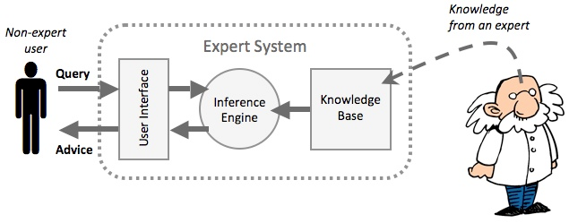
What is an Expert System ?

Slide 3
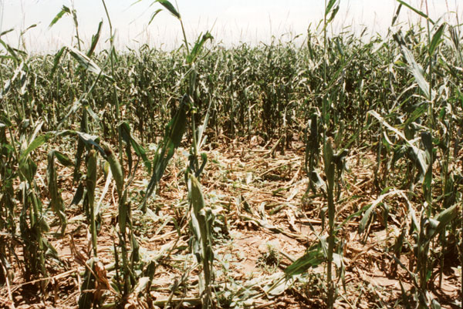
Big Problem – Food Security
Pests & Diseases => Crop Losses

Slide 4
Introduction
Plant Doctor (Knowledge Based Expert System) will ask the user some questions and then diagnose the chosen plant based on symptoms and their confidence levels. After successful diagnosis it provides advice like an expert which includes treatment, chemical control etc.

Slide 5
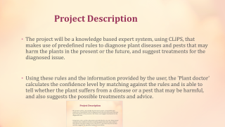
Project Description
The project will be a knowledge based expert system, using CLIPS, that makes use of predefined rules to diagnose plant diseases and pests that may harm the plants in the present or the future, and suggest treatments for the diagnosed issue.
Using these rules and the information provided by the user, the 'Plant doctor' calculates the confidence level by matching against the rules and is able to tell whether the plant suffers from a disease or a pest that may be harmful, and also suggests the possible treatments and advice.

Slide 6
Flow Chart for plant doctor (Knowledge Based Expert System)

Slide 7
Software and Tools used
Programming Language : CLIPS
Platforms Supported : Multiplatform
Architecture of Expert System – Knowledge Based Expert System

Slide 8
Functional Requirements
Inputs:-
Calculation Mode (ON/OFF)
Plant Name
Presence(YES/NO) of symptoms
Output:-
Calculations
Diagnosis
Advice

Slide 9
Non Functional Requirements
Performance
A disease cannot be diagnosed using only a single symptom therefore this expert system asks the presence of numerous systems and then calculates the confidence level of a disease using the weights assigned to each symptom. It then gives advice and diagnosis based on these calculations
Safety
No inappropriate advice is mentioned.
Reliability
System should be reliable in the sense that functionality of the program is preserved and desired output is obtained.
Usability
Can be used by different groups of people.

Slide 10
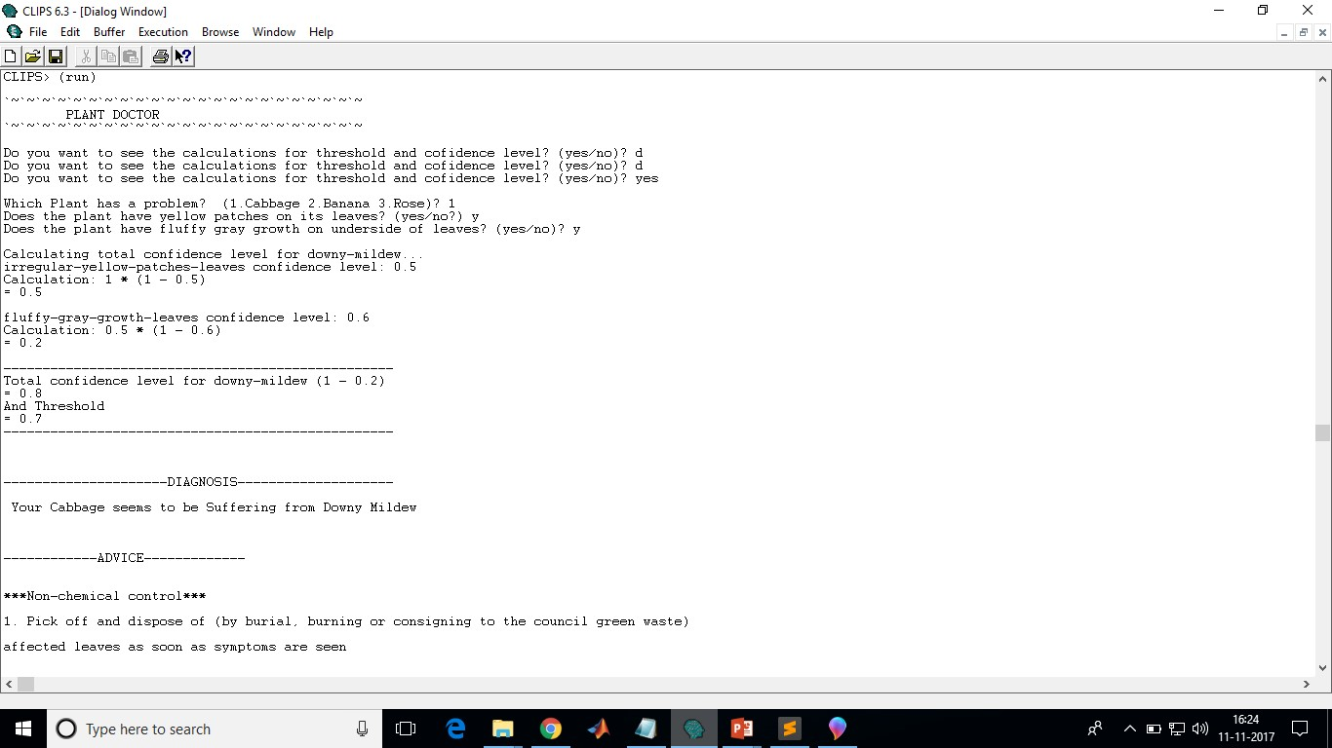
System Demo

Slide 11
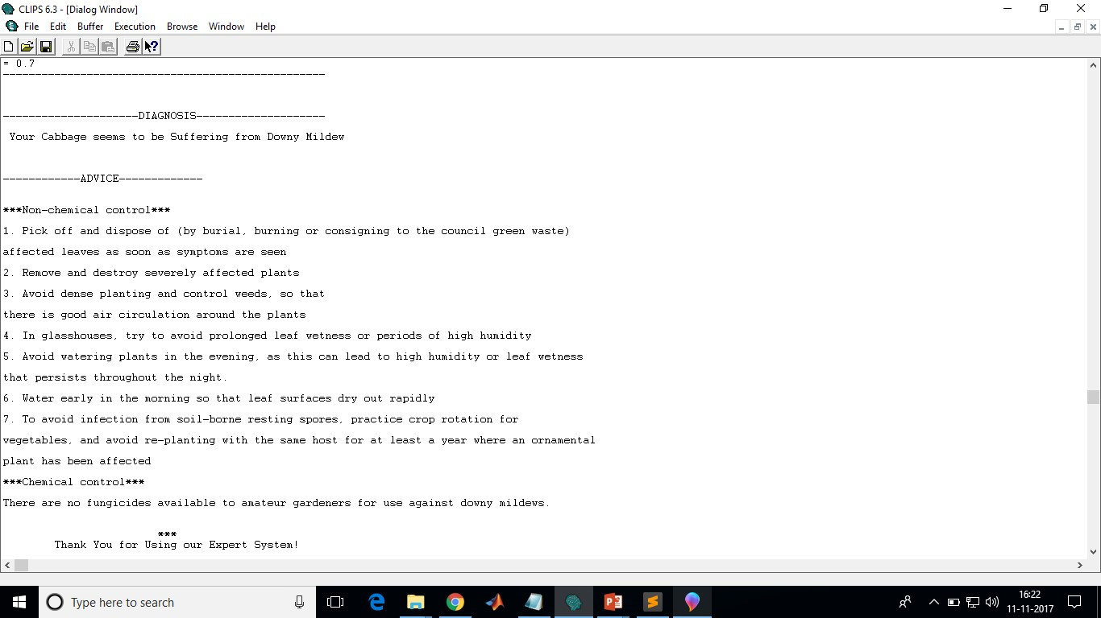
System Demo

Slide 12
Thank you!

